Slide 1



Neural music classification
Prof. Barbara Caputo
A.Y. 2020/2021
TA: Giuseppe Rizzo
Vincenzo Marciano’, s282004@studenti.polito.it
Vincenzo De Marco, s290373@studenti.polito.it
Michele Dicataldo, s290091@studenti.polito.it

Slide 2


Overview
The project’s aim is to adapt a Convolutional Recurrent Neural Network (CRNN)to two aspects of music classification: Genres and Moods.
A comparison with an SVM-based model has to be don, to evaluate different approach performances.
As a final point, new song must be evaluated both by genre and mood, exploiting a multi-label classification.

Slide 3
Proposed steps
Creating slices for each song in the datasets.
Creating Mel’s Spectrogram for each sample
Data augmentation
Preprocessing
training
Trying different parameters
Training the suggested model with Early Stopping, while checking the loss variation.
Adapting the architecture to Mood classification
results
Assessing the results in Testing phase (Accuracy and F1-score)
Comparison between SVM and CRNN for genre classification
Evaluation
Feeding the software with new songs
Making an assessment on the overall behaviour (Multi-label classification)
Neural Music Classification

Slide 4
Preprocessing
MEL’S SPECTROGRAM
DATASETS
Combining STFT with a Mel’s Scale to provide the best tensor representation for input data
GTZAN for genre classification, wav files, mono channel, 10 genres
SPOTIFY APIs to create a custom dataset, mp3 files, stereo channel, 5 moods
SLICING
AUGMENTATION
Creating slices for each song (1s, 3s, 5s, 10s)
Shuffle each audio excerpt for each genre to emulate a iid sample set
Exploiting Torchaudio to modify the samples with noisy and masking techniques, both in time and frequency domain

Slide 5
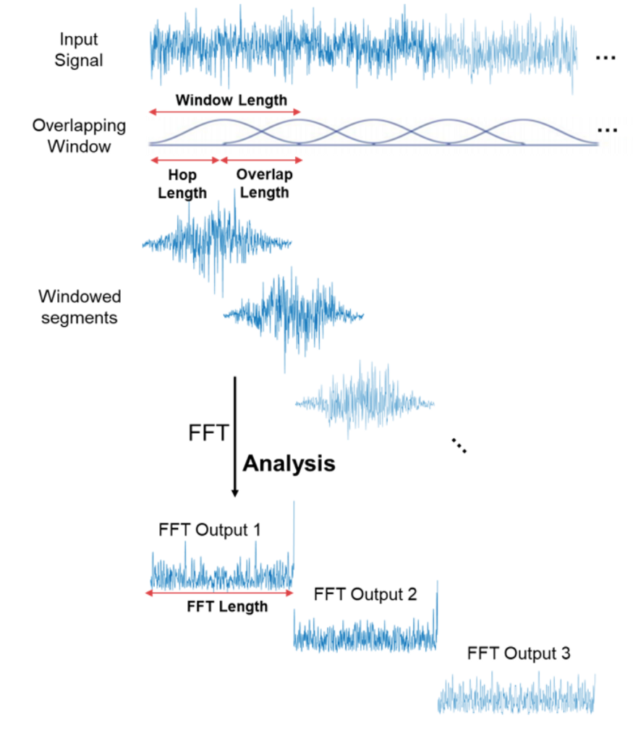
spectrograms
SEPARATING SIGNAL INTO WINDOWS
Each overlapping window begins with a hop_leght=512 after the previous one.
COMPUTING STFT
Computing STFT, i.e. FFT on the windowed portion of signal. The size is given by n_fft=2048.

Slide 6
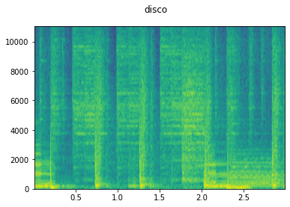
Mel’s spectrograms
SCALING INTO MEL’S SCALE
Compressing the frequency range into a log-scale (n_bins=128)
then converting the amplitude in dB.
RESULTS
Audio sample are now more manageable, imputed as independent 3D tensors (time, frequency, channel)
For stereo samples, the average value along the two channels is considered.

Slide 7
DATASETS
SPOTIFY
GTZAN
Embedding Spotify APIs (Spotipy) to build our custom dataset
Songs have been chosen from the 2021 most listened playlists
5 moods
Variable number of songs for each mood
30 second previews for each song
Mp3
Stereo Channel
44 kHz sampling
10 genres
100 audio tracks per genre
30 seconds excerpts for each song
Wav
Mono channel
22 kHz sampling

Slide 8

SLICING
Torchaudio as backend environment to module auditory tensors
TRAIN / TEST / VAL SPLIT
Splitting each dataset into Train (72%), Test (20%), Validation (18%) sets.
slicing by genre
Slicing each song in each set by genre by the chosen window (1s, 3s, 5s, 10s) and creating a tensor for each excerpt.
SHUFFLING AND DATA LOADER
Shuffling each set, then chain each tensor in a Data Loader and shuffling again.
Process made for Train, Test and Validation (iid samples)
Batch size set to 16.

Slide 9
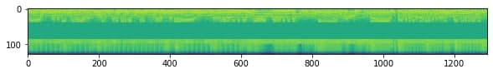
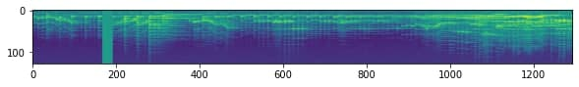
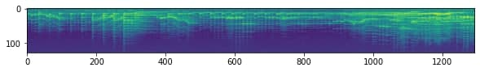
DATA AUGMENTATION
TIME/FREQUENCY MASK
TIME WARP
Torchaudio as backend environment to make augmentation
ADDING NOISE

Slide 10
training

Slide 11
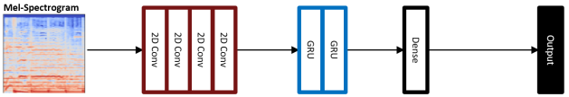
MODEL ARCHITECTURE
CRNN
Outstanding performance in the most recent audio classification works
Embedded modules
1x Batch Norm
4x Conv Block
2x Recurrent Block
1x FC
Spatial and temporal features retrieved, stylistic pattern investigation

Slide 12
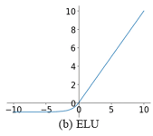
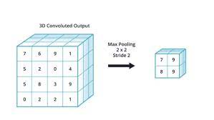
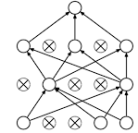
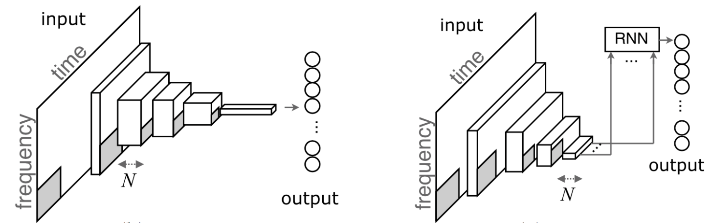
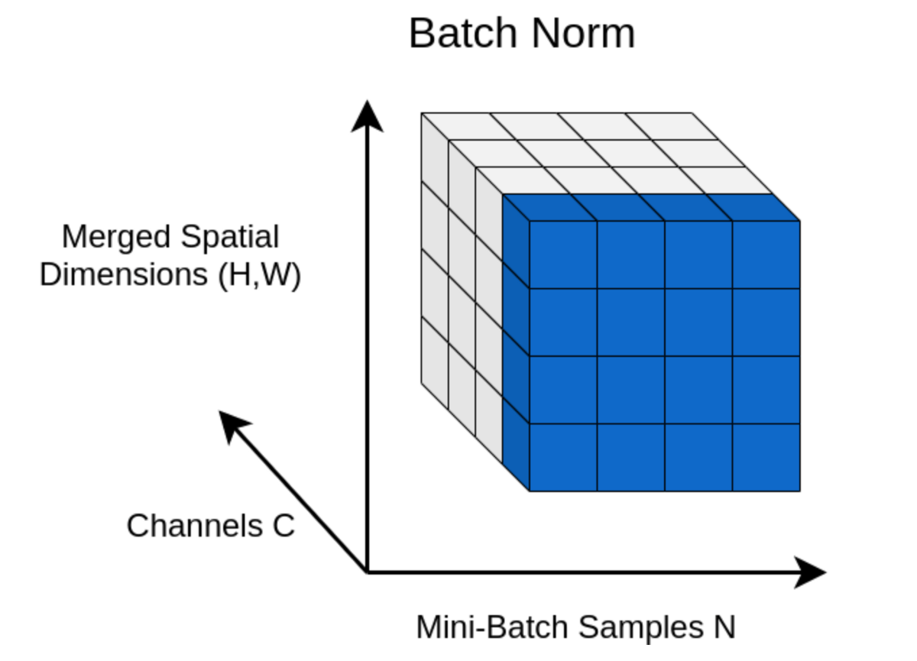
4xCONVOLUTIONAL MODULEs
CONVOLUTIONAL LAYER
ACTIVATION FUNCTION
BATCH NORMALIZATION
MAX POOLING
(AVG POOLING)
DROPOUT
Kernel = 3x3
Filters = 64, 128, 128, 128
Padding = 1
Exponential Linear Unit (ELU)
2D Batch Normalization
2D projection
Window = 2x2, 4x2, 4x2, 4x2
Stride = 1
Parameter to be tuned
0.1, 0.3 as imputed values

Slide 13
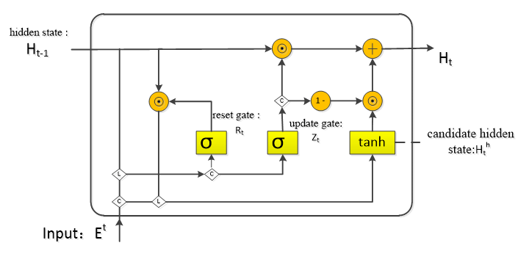
2xRECURRENT MODULEs
GRU
Hidden State Features: 32, 32
Retrieving temporal informations
Better choiche instead of LSTM for audio tasks
Update gate: decides what to throw away and what new infos to add;
Reset gate: decide how much of past information to forget
2020/2021
Neural Music Classification

Slide 14
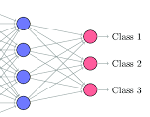
1xFully connected block
DROPOUT
Linear layer
Number of inputs = number of previous layer’s neurons
Number of outputs = number of classes (10 for genre, 5 for mood)
…
2020/2021
Neural Music Classification

Slide 15



Training parameters
0.3
200
0.001
dropout
Learning rate
epochs
0.01
15
delta
patience

Slide 16
Training functions
adam
0.0005
Cross entropy
optimizer
Weight decay
Loss

Slide 17
Mood network
Let’s get less discriminative
Patterns are not so well defined
There is less distinction between moods
MODEL STRUCTURE
Same as GTZAN architecture
AVG POOLING instead of Max Pooling

Slide 18
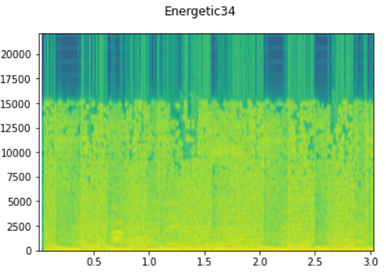
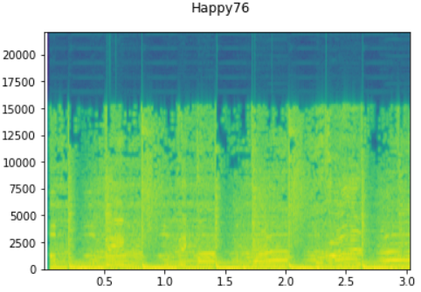
Key concepts
Spectrograms in this task are very different from the genres one.
More informations to retrieve from a spectrogram
«Energetic» Sample
«Happy» Sample

Slide 19
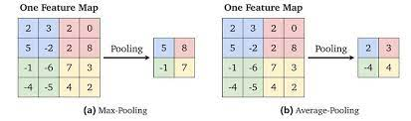
Avg pooling
It does the Average across the imputed subwindow values
Takes in consideration the surrounding behaviour of the sample
It solves the «fading behaviour» among all the moods’ spectrograms
Increase performances

Slide 20
results

Slide 21
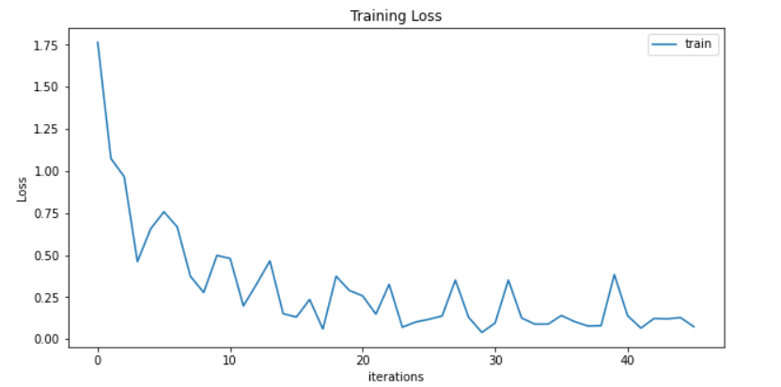
Genres classification
 | Accuracy | F1-Score
1s | 0.890 | 0.889
3s | 0.920 | 0.922
5s | 0.690 | 0.679
10s | 0.570 | 0.534

Slide 22
Russel’s taxonomy
Helping in identify a more empiric taxonomy for moods
2D plane to visualize the division
5-segments choice
Arousal +
ENERGETIC
HAPPY
Valence -
Valence +
DARK
SAD
RELAXING
Arousal -

Slide 23
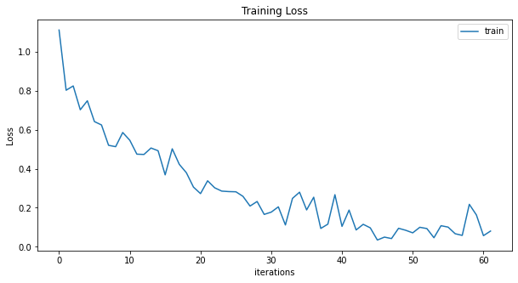
Moods classification
 | Accuracy | F1-Score
GTZAN Net with MaxPooling | 0.70 | 0.69
Our Proposal with AvgPooling | 0.74 | 0.74
Maintaining 3s window since they outperform the other slicing divisions
Good performances, even though dataset is unbalanced and taxonomy is limited to 5 categories

Slide 24
Comparison with svm
NO SLICING WINDOWS
NO TEMPORAL INFORMATIONS
CREATING A VECTOR OF HAND-EXTRACTED FEATURES (MFCC, SPECTRAL INFOS…) FOR EACH SAMPLE
SUPERVISED
SVM
SPATIAL FEATURES
TEMPORAL FEATURES
LEARNING TYPE
Acc.
0.61
CRNN
SPATIAL FEATURES
TEMPORAL FEATURES
LEARNING TYPE
0.92
Acc.
MEL’S SPECTROGRAM AS REPRESENTATION FOR EACH INSTANCE
3s SLICING WINDOW TO OPERATE WITH
RECURRENT MODULES FOR TEMPORAL FEATURES
SUPERVISED

Slide 25




New songs evaluation
FRITZPLEASURE
REMINDER
715-CRΣΣKS
Alt-J
Moderat
Bon Iver

Slide 26
Multi-label classification
Nowadays songs can’t be described only by one genre or mood
Proposed audio tracks’ authors are quite experimental
715 - CRΣΣKS
FITZPLEASURE
REMINDER
Genre (%) | Moods (%)
Jazz (47.50) | Sad (45.00)
Pop (20.00) | Dark (26.92)
Classical (15.00) | Relaxing (10.00)
Others (17.50) | Others (12.50)
Genre (%) | Moods (%)
Rock (46.16) | Sad (52.38)
Pop (25.81) | Dark (23.81)
Hiphop (11.29) | Relaxing (14.29)
Others (17.74) | Others (9.52)
Genre (%) | Moods (%)
Rock (46.75) | Sad (37.18)
Pop (19.48) | Energetic (26.92)
Hiphop (11.69) | Happy (17.95)
Others (22.08) | Others (17.95)

Slide 27

Future directions
Parallel nns
Exploiting sentiment analysis in parallel through a Speech Recognition model
Million song dataset
Enhancing performances by feeding the network with a larger dataset
New activation functions
Recent study focused on the novel PELU activation function.

Slide 28
Thanks for your attention!

